Slide 1
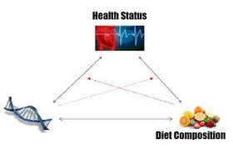
Nutrigenetics Nutrigenomics Epigenetics
By: Danielle Bray

Slide 2
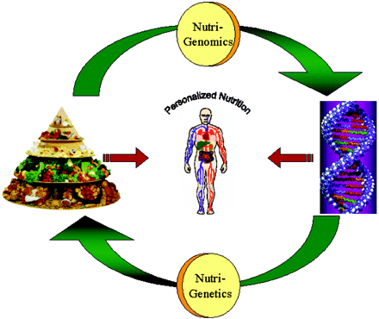
Definitions
1.Nutrigenetics-genetic makeup affecting dietary response
2. Nutrigenomics-dietary ingredients and nutrients affecting gene expression
3. Epigenetics –gene expression or repression
http://www.youtube.com/watch?feature=player_detailpage&v=Xjq5eEslJhw#t=169s
(Mutch, 2005, p. 1603)
(epigenetics, 2009)
Notes:
Not looking at genetics and environmental factors (in this case, diet) as separate influences on human health
Nutrigenomics-gene expression further affecting absorption, transport, storage, excretion, etc.
Epigenetics-gene expression as it relates to when and how the genes are turned on or off

Slide 3
Why it is important
Differences in bioavailability among individuals of the same ethnicity
Differences in dietary choices and food availability based on culture, taste, and geography
Malnutrition leading to genetic mutations through altered gene expression
(Fenech, 2011)
Notes:
Individuals of the same ethnicity have very similar genomes(all the genetic information of an organism)
-question whether differences in bioavailability are due to genetic mutations or environmental influences on the genetic phenotype
3. Malnutrition relating to deficiency or excess

Slide 4
Outline
Nutrigenetics
Nutrigenomics
Epigenetics
Benefits/Complications

Slide 5
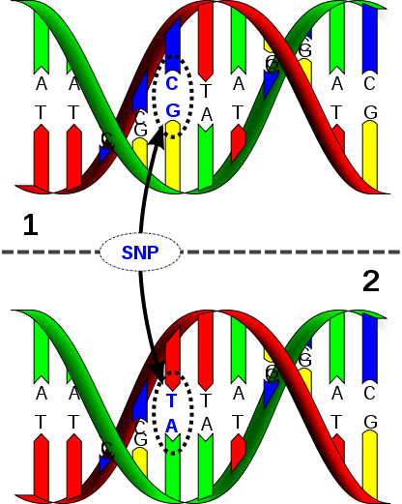
Nutrigenetics
Examines the nutrition related genes, specifically mutated genes, and their affect on micro/macronutrient uptake and metabolism
Mutations:
Single-Nucleotide Polymorphisms
Insertions
Deletions
(Fenech, 2011)
Notes:
mutations can occurring at the DNA level; mutations can lead to physical differences such as hair or eye color, have no affect, or lead to complications in body functioning (increase susceptibility to disease or different responses to a particular drug)
SNPs-variations at a single base pair
(for example “A” base pairs with the “T” base; in SNPs “A” will bind with “G’)
10 million SNPs in the human genome
Insertions: GG

Slide 6
Applying Nutrigenetics
Coffee and CVD (Cornelis, 2007)
“slow” vs. “fast” caffeine metabolism gene
Celiac Disease (Romanos, 2009)
genetic screening
Notes:
Coffee and CVD: study focuses on boiled caffeinated coffee; moderate caffeine consumption has shown positive correlations to CVD, but this study looks at the harmful affects of caffeinated coffee on CVD. These harmful effects are not consistent with all individuals. People with “slow” gene are more impacted than “fast” metabolism gene. Appreciate that although the environmental stimulus was the same, the difference in genes can make one person more susceptible to particular health complications
Celiac Disease: allergy to gluten-containing products; example of a diet specific to individuals with specific genetic mutations(in nutrition counseling and marketplace); disease not screened by genetic studies but could be in the near future

Slide 7
Nutrigenomics
Diet
Proteomics
Metabolomics
Epigenetics
Genetic Stability
(Fenech, 2011)
Notes:
-these changes can be an adaptive response to environment or diet, not necessarily irreversible damage
We look at diet in nutrigenomics, but other environmental factors such as UV light, oxidative stress, or chemicals can effect genome stability
Proteomics-protein expression
Genome instability-errors in cell metabolism or DNA replication can affect nucleotide modification or DNA breakage

Slide 8
Applying Nutrigenomics (Dolinoy, 2006)
Genistein
Phytoestrogen in soy products
Female Mice
During gestation
Results
Phenotype alteration through methylation
Protected offspring from obesity
High quantity
Notes:
-methylation continued through adulthood of offspring

Slide 9
Epigenetics (Fenech, 2011)
Methods of gene alteration
1. DNA Methylation
a. addition of methyl group
-remodels chromatin
-inhibits binding of transcription factors
2. Histone Modifications
-post-translational
-alter interactions between DNA and protein
Notes:
Chromatin: combination of DNA and protein
-methyl moves chromatin to its inactive state
-silenced for disease prevention
Histones-package and order DNA

Slide 10
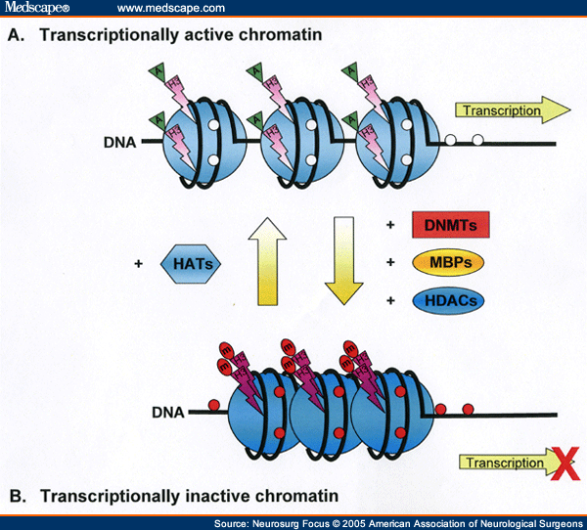

Slide 11
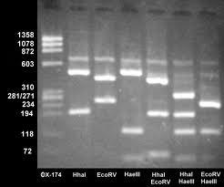
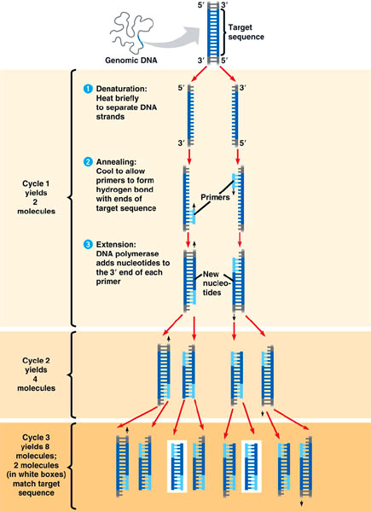
Methods
Microarrays
Measurement of whole genome
Determines expressed/repressed genes
Electrophoresis
Separation of molecules based on chain length
Polymerase Chain Reaction (PCR)
Amplification of a specific gene
(Microarrays) (Fenech, 2011)
Notes:
Research studies in mice, humans and cell cultures
-Often use a Candidate gene approach to analyze one gene based on its known function and determine number of SNPs
-Candidate genes: genes that are more susceptible to effects of diet
-microarrays used to analyze genes from 2 populations of different conditions
-electrophoresis: using gels and electrostatic attraction to move DNA, RNA or protein. Chain length determines speed of movement

Slide 12
Benefits vs. Complications
Benefits
Complications
Personalized Diets (life stage, dietary preferences, health status)
New food products
Public health recommendations-linking specific food to health conditions
(Fenech, 2011)
Food selection influenced by convenience, price, taste, social environment
Training of health professionals
Literacy levels
Notes:
Ultimately for disease prevention but insufficient data prevents application of nutrigenetics/nutrigenomic/epigenetic studies

Slide 13
References
Cornelis, M., & El-Sohemy, A. (2007). Coffee, caffeine, and coronary heart disease. Current Opinion in Clinical Nutrition Metabolism and Care , 745-51.
Dolinoy, D., Weidman, J., Waterland, R., & Jirtle, R. (2006). Maternal Genistein Alters Coat Color and Protects Avy Mouse Offspring from Obesity by Modifying the Fetal Epigenome. Environmental Health Perspectives , 567-572.
epigenetics. (2009, September 30). Retrieved February 17, 2012, from youtube: http://www.youtube.com/watch?v=Xjq5eEslJhw
Fenech, M., El-Sohemy, A., Cahill, L., Ferguson, L., French, T.-A., Tai, E., et al. (2011). Nutrigenetics and Nutrigenomics: Viewpoints on the Current Status and Applications in Nutritional Research and Practice. Journal of Nutrigenetics and Nutrigenomics , 69-89.
Genome instability. (n.d.). Retrieved February 18, 2012, from nature: http://www.nature.com/nrm/focus/genome-instability/index.html
J, R., CC, V. D., & Notle, I. (2009). Analysis of HLA and non-HLA alleles can identifu individuals at high risk for celiac disease. Gastroenterology , 834-840.
Microarrays. (n.d.). Retrieved February 18, 2012, from MediaBook: http://gcat.davidson.edu/Pirelli/index.htm
Mutch, D., Wahli, W., & Williamson, G. (2005). Nutrigenomics and nutrigenetics: the emerging faces of nutrition . FASEB Journal , 1602-1616.

