Slide 2
Make half your plate fruits and vegetables.

Slide 3
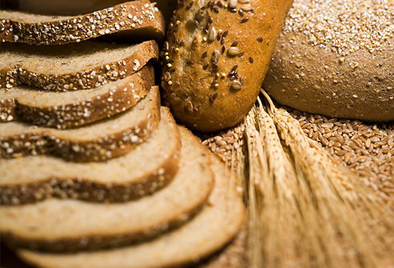
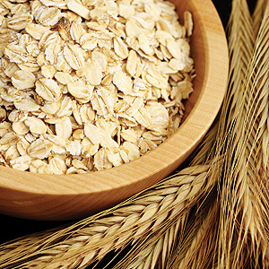
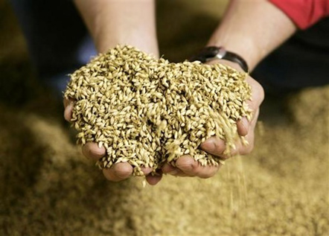
Make at least half your grains whole.

Slide 4
Switch to fat-free or low-fat milk.

Slide 5
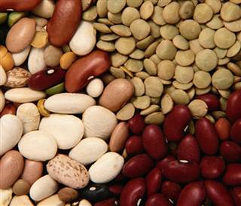
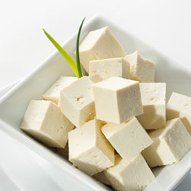
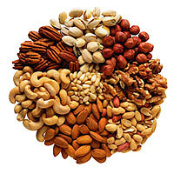
Vary your protein choices.

Slide 6
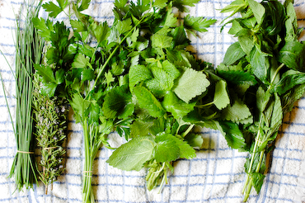
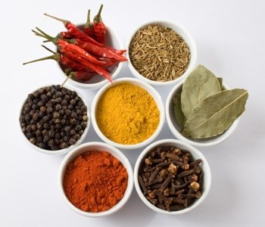
Cut back on sodium.

Slide 7
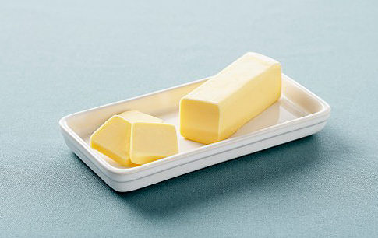
Reduce empty calories from solid fats.

Slide 8
Cut back on added sugars.

Slide 9
Enjoy your food in moderation.

Slide 10
Be physically active in your way.

