Slide 1
Food Safety
Presented by: Danielle Bray

Slide 2
Foodborne Illness
What is it?
A disease carried/transmitted to people by food
Who gets it?
Anyone, but specifically high risk populations:
Infants/preschool age
Pregnant women
Elderly
Those with compromised immune systems
Notes:
The government estimates that 1 in 6 is sickened by foodborne illness every yr.
Foodborne Outbreak: when 2 or more people get the same illness after consuming the same food.
Compromised immune systems: people with cancer, chemotherapy, transplants, HIV/AIDS

Slide 3
Symptoms
Common Symptoms
Severe Symptoms
Flu-like
-Abdominal cramps
-Diarrhea
-Nausea/vomiting
-Fever
-Miscarriages
-Kidney Failure
-Difficulty speaking/swallowing
-Joint/muscle pain
-Disorientation
-Memory loss
Notes:
Anasakiasis=coughing up worms (raw/undercooked fish)

Slide 4
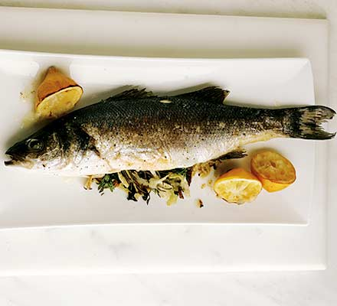
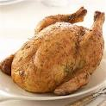
TCS Foods
Notes:
TCS foods- foods that need temperature control for safety-have favorable characteristics for microorganisms to grow (acidity levels, moisture, oxygen)
Also: shellfish, meat. Eggs, heat-treated food (beans/veg/rice), tofu/soy protein

Slide 5
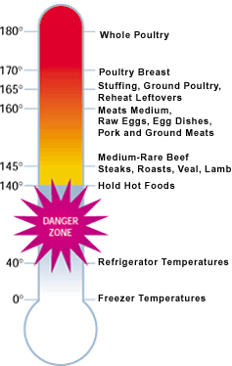
Risk Factors
Non-reputable suppliers
Improper cooking/reheating
Improper holding
Contaminated Equipment
Poor personal hygiene
Notes:
Risk Factor: something that can increase the likelihood that something else will occur, whether good/bad
Non-reputable suppliers:extremely important when buying meat/poultry products and seafood/shellfish-contaminated water
Improper holding-holding at wrong temperatures, time in TDZ, improper cooling
Cross contamination: when microorganisms are transferred from 1 surface/food to another
Important when taking into account allergies/intolerances-use example
Due to contaminated equip not clean-towels, utensils
physical touch
food drippings of contaminated food to Ready-to-eat foods

Slide 6
Personal Hygiene
Poor Habits
Healthy Habits
Coughing/Sneezing into sleeve
Wearing clean clothes when preparing food
Using hand sanitizer if washing hands is not possible
Sick at work
Touching wounds/hair/nose and immediately touching food
Not washing hands after eating, smoking, etc.
Preparing food when sick
Improper hand washing*
Notes:
If you don’t wash hands before eating lunch, make a salad and touch spoons/tongs, another person touches utensil and then eats a burger or handheld food.
Hand Sanitizer-must be 60% alcohol

Slide 7
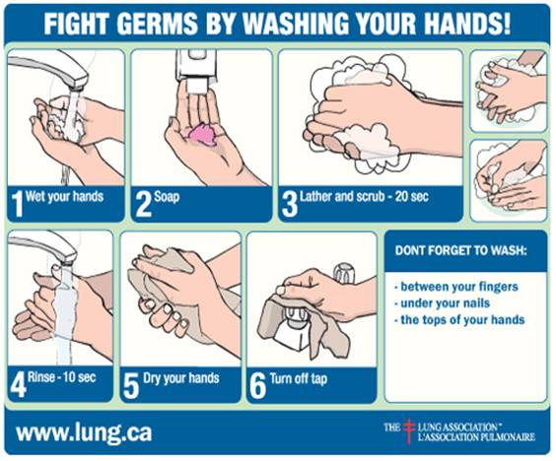
Hand Washing
Notes:
Use water as hot as you can comfortably stand-100F

Slide 8
Food Safety for Thought
Use cooked leftovers within 4 days
Mold is only acceptable for foods where molding is a natural part: Brie, Gorgonzola, firm fruit/vegetables
Thawing:
Refrigerator
Cold water
Microwave
Cooking process
Notes:
Refridge-longer process (up to 3 days), make sure not dripping onto other food
Cold water-running water/submerge in cold tap water in leak proof bag (change water every 30 min)
Cold water/microwave: food must be cooked immediately after

Slide 9
Food Storage
Vegetables/Produce/
Ready to eat
Whole Fish
Whole Meat
Ground Meat
Poultry

Slide 10
Questions????

Slide 11
Works Cited
Association, N. R. (5th Edition ). ServSafe Coursebook.
Basics for Handling Food Safely . (n.d.). Retrieved October 27, 2011, from FDA: http://fda.org/index.php?article=basics-for-handling-food-safely
Fight germs and wash hands properly . (2009, July 27). Retrieved October 27, 2011, from The Lung Association: http://lung.ca/protect-protegez/germs-microbes_e.php

