Slide 2
Responsibilities
Registered Dietitian
Dietetic Technician Registered
“Food and nutrition expert”
Treatment and prevention of disease
Delivery of MNT
Hospitals, private practice, other health care, community, academia, research, business, sports, wellness, food industry
“Food and nutrition practitioner”
Work in conjunction with RD
Health care: MNT
Clinics
Community/public health
Schools/day-care
WIC
Notes:
Accreditation Council for Education in Nutrition and Dietetics (ACEND) of the Academy of Nutrition and Dietetics.

Slide 3
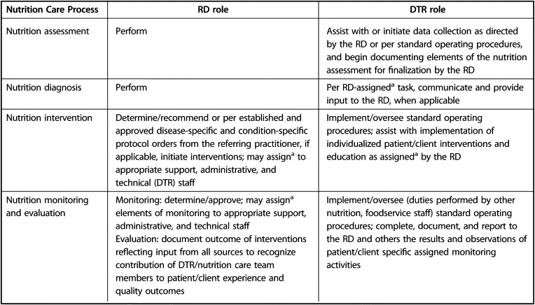

Slide 4
Becoming a RD(N)

Slide 5
Step 1: Education
Bachelor’s Degree
U.S. accredited university or college
Ohio University
Maintain 2.0 (C or better) overall GPA
Earn 2.0 in all major courses
http://www.ohio.edu/chsp/ahsw/academics/and.cfm
Program director: David Holben Ph.D., R.D., L.D. (holben@ohio.edu)
Verification Statement
When: bachelor’s or graduate degree
Accredited: ACEND (Accreditation Council for Education in Nutrition and Dietetics) of the Academy of Nutrition and Dietetic
Signed by program director
Notes:
ACEND formerly known as CADE: accrediting agency for educational programs to become RD or DTR (for CDR eligibility for registration examination for dietitians and DTR)
-Coursework and supervised practice experiences may vary from program to program. They are determined by the program director so students must be the requirements of their individual program.

Slide 6
Step 2: Internship
ACEND-accredited supervised practice program
8-12 months
Health care facility, community agency, foodservice corporation
Optional Coordinated Program

Slide 7
Step 3: Registration and Licensure
Commission on Dietetic Registration (CDR)
(http://cdrnet.org/)
National examination
Licensure (select states)
Continuing education
Portfolio
Notes:
CDR: credentialing agency for the Academy of Nutrition and Dietetics. The purpose of the Commission is to serve the public by establishing and enforcing standards for certification and by issuing credentials to individuals who meet these standards

Slide 8
Becoming a DTR
Option 1:
Option 2:
2-years associate’s degree at US accredited university of college
450 hours supervised practice
Accredited by ACEND
DTR examination
Bachelor’s degree at US accredited university or college
Required coursework for Didactic Program (DPD) or Coordinated Program (CP)
DTR examination

Slide 9
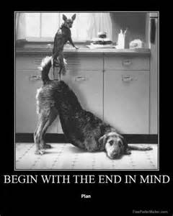
Building a Mission Statement
http://www.franklincovey.com/msb/
Personal Statement
Inspiration
"Always start every endeavor
with a clear sense of purpose."
-Franklin Covey
Notes:
Begin with the end in mind
Provides a framework or guide when making decisions and choosing which paths to take

Slide 10
Professional Development: Emails
Professional Email
Subject: Information regarding research position
Dear Professor Johnson,
I am contacting you in regards to the available position as your student research assistant. My name is Scott Robertson and I am currently a senior studying Applied Nutrition with a concentration in dietetics. Dr. Cunningham notified me of the research position and advised me to contact you in order to learn more about what the job entails. I would greatly appreciate if you could provide me with a brief description of the job duties, what kind of prior experience you are looking for, as well as an application deadline. Kindly send me any other details that you feel are important. I look forward to hearing from you.
Best regards,
Scott Robertson
Senior Applied Nutrition Major
College of Health Sciences and Professions
(740) 555-5555
Notes:
Professional Components:
1. Clear subject line
2. Formal greeting
3. Clearly stating your purpose early in the email
4. Proper punctuation
5. Polite closing remarks
6. Signature with appropriate contact information

